Slide 1
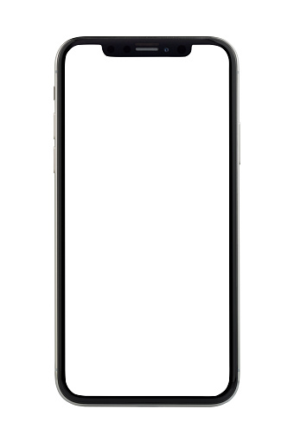
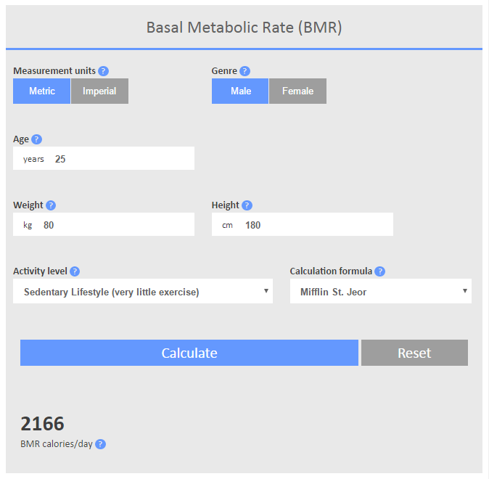
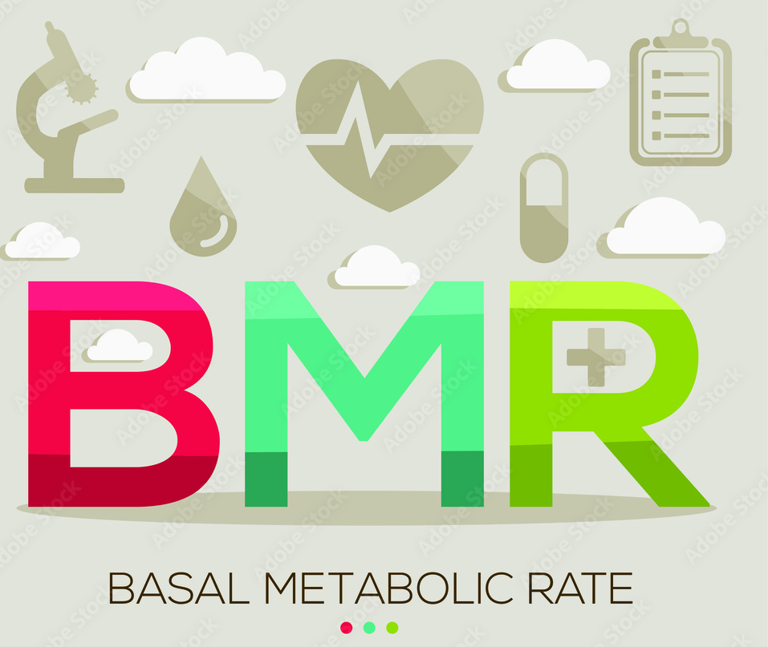
User Story: as a user I want to calculate my BMR (Basal Metabolic Rate), so that I know how many calories I need to lose, maintain or gain weight. Given my age, gender, height and weight, When I click “Calculate BMR” Then I can see the amount of calories I need daily.

